Slide 1
CITES PaperCut
Printing for Departments

Slide 2
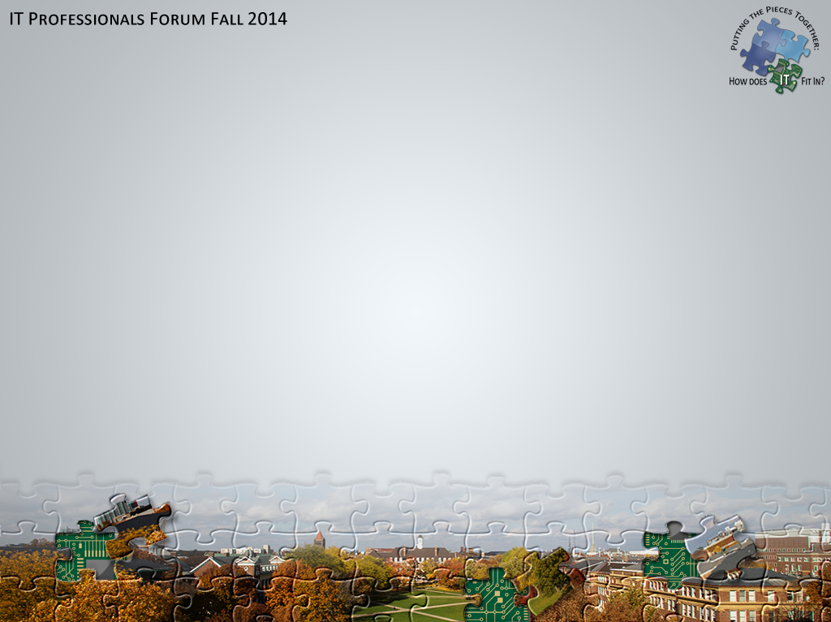
Stephen J. Butler
CITES Senior Software Developer (sometimes sysadmin)
ICS: Instructional Computing Services
Started as a student in 2000
4th print billing system

Slide 3
PaperCut Overview
Common Scripts
CITES PaperCut Application

Slide 4
PaperCut Overview
Accounting Application
Print Configurations
Costs
Access Restrictions
Scripting
Notes:
PaperCut does a lot of extra things: WebPrint, Google CloudPrint, facilitate iOS. But it’s core is accounting.
Still run your print servers as you always have; PaperCut hooks into them.
Large part of it is printer configurations.

Slide 5
PaperCut Overview
User Accounts
Default
iCard
?Departments?
Shared Accounts
Notes:
Default: transactions that we will export to Banner
iCard: when it’s available, how we will track transactions involving an iCard balance
Departments: credits from departments that are available on all printers; should involved a CFOP
The user has no control over how personal accounts are selected.
Shared accounts: associated with individual users or groups; selected by user

Slide 6
PaperCut Overview
CITES Setup
25 locations
50 printers
Windows, OS X, and iOS
Remote (laptop) printing
300+ printer configurations in PaperCut
Notes:
All the different platforms means we support a lot of configurations for few physical printers.
Choices we made try to minimize the difference between configurations.
4 common configurations copied among all our printer agents.

Slide 7
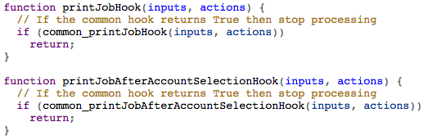
Common Scripts
server/custom/print-script-common.js
Notes:
File is automatically included for every printer in the system.
How we provide common routines for the configurations; customizable.
Printers call a hook into the common routines.

Slide 8
Common Scripts
Shared Account/Printer Restriction: Scenario
Account: “CITES-ICS Department Credit”
Printers: “Department:ICS”
No native way to restrict this account to a printer group
Notes:
Many departmental credits for their own users; no CFOP or funds associated with them.
Must be restricted to a set of printers managed by the department.

Slide 9
Common Scripts
Shared Account/Printer Restriction
Name Account: “[Department:ICS] CITES-ICS Department Credit”
Normal account selection popup
Script to enforce the printer group
Option: checkAccountPrinterGroup: true
Notes:
Let’s do it through scripting!
Choose a naming convention that includes the the printer group.
Script looks for this naming convention, and checks the printer group.

Slide 10
Common Scripts
Discount Groups: Scenario
Standard rate
Color: $0.40; B&W: $0.10
Group: “CITES-ICS-Staff”
Color: $0.20; B&W: $0.05
Notes:
Housing has asked us to offer a discount rate to residents. How to apply?
In general, what if multiple discounts might apply?

Slide 11
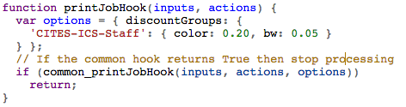
Common Scripts
Discount Groups
Option: discountGroups
Applies best discount
Notes:
Scripting to the rescue again.
Script defines a special rate for particular group; calculates and chooses the best discount.
Does not currently account for different paper sizes.

Slide 12
Common Scripts
Site Restricted Users: Scenario
Conference & Guest Users
Allow printing at single site
Deny printing at all other sites
Notes:
Default: only NetID accounts are allowed to print. What about guests and conferences?
Want to allow them printing at only a single location.

Slide 13
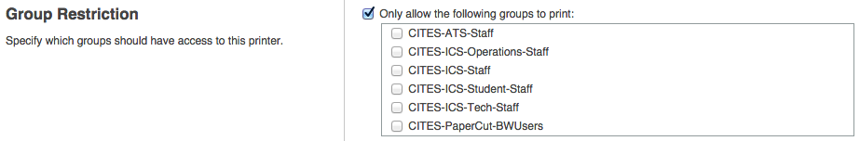
Common Scripts
Site Restricted Users: Native Way
Use Group Restriction
Pro: easy; Con: different for each site
Notes:
PaperCut does let us do this natively. Use group restrictions.
Already doing this to only allow NetID accounts: UOFI\UIUC Campus Accounts
Becomes difficult to scale to many sites.

Slide 14
Common Scripts
Site Restricted Users: Scripted Setup
Standard name for printers: “ug-250-bw”
Option: siteRestrictUsers.printerNameRegexp
AD site groups: “CITES-PaperCut-SiteUsers-UG”
Option: siteRestrictUsers.groupNameTemplate
AD restricted group: “CITES-PaperCut-SiteUsers”
Option: siteRestrictUsers.restrictGroupName
Notes:
We can do this with scripting if we adopt a couple conventions.
Choose a standard way of naming printers that includes the site name
Choose a standard way of naming site restricted groups (would still be needed for native option)
Workflow: checked if restricted; get the site name from the printer name; check site group.

Slide 15
Common Scripts
Site Restricted Users: Scripted
Pro: as easy as managing AD groups
Pro: no additional PaperCut configuration
Con: more complicated

Slide 16
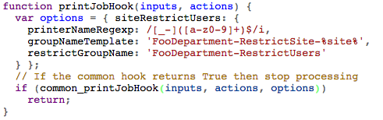
Common Scripts
Site Restricted Users: Scripted
Notes:
Is customizable if you don’t like our naming conventions.

Slide 17
Common Scripts
Available Today
https://github.com/sbutler/papercut

Slide 18
CITES PaperCut Application
Django
Provides additional functionality
Notes:
Times when PaperCut is not enough.
We have our own application that extends its functionality in a couple ways.

Slide 19
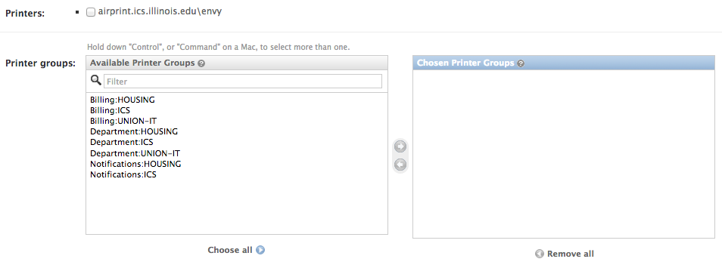
CITES PaperCut Application
Claiming Printers: assigns initial groups
Notes:
Department admins needs to assign printer groups to new printers.
Would like to limit the number of super admins in the system.
Developed a “claim printer” interface.

Slide 20
CITES PaperCut Application
Release Queues: Native
Release Station: $185/site
PaperCut Web Release
Notes:
All of our queues are hold/release queues.
With 25 sites we didn’t want to pay the license cost.
Also, the login first select jobs second model not how we traditionally do it.

Slide 21
CITES PaperCut Application
Release Queues: CITES Web Release
Flipped model: show jobs, then authenticate
Based on location
Supports targeted release (Find-Me-Printing)
No additional licenses
Notes:
There is a release station API published.
Targeted printing not something we’re doing right now. If it’s popular, could make for busy queues

Slide 22
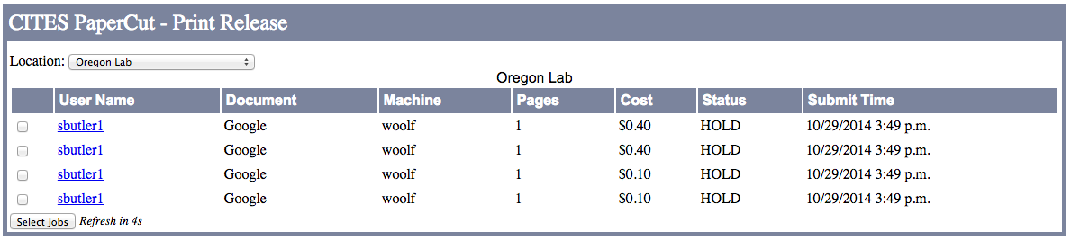
CITES PaperCut Application
Release Queues: CITES Web Release
Notes:
Basic informational view. Select one or more jobs. Authenticate. It prints.

Slide 23
CITES PaperCut Application
User Batches: Department Credits
Individual Shared Account
Data Sources: PaperCut group; UOFI group; Web service
Periods: date range and credit amount
Parent Account
Notes:
Individual shared account: a shared account assigned to a single user.
User batches let us easily manage shared accounts for groups of users.
LDAP does not support nested; use PaperCut groups for that.
Parent account can have a CFOP, or can be named to restrict subaccounts to a printer group

Slide 24
CITES-PaperCut Application
User Batches: Department Credits, Example
DataSource: “UOFI\FooDepartment-Users”
Period: [2014-08-01, 2015-01-01), $50.00
Parent Account: “[Department:Foo] Foo Users Credit”
Notes:
This is how we are handling department credits

Slide 25
CITES PaperCut Application
User Batches: Department Credits, Example
[Department:Foo] Foo Users Credit\sbutler1, $50
[Department:Foo] Foo Users Credit\hgharst, $50
[Department:Foo] Foo Users Credit\chndrcks, $50
…
Notes:
Runs nightly
Enter period: credit is set
Leave period: account is disabled
Add user: gets new account; Remove user: account deleted

Slide 26
CITES PaperCut Application
User Batches: Department Credits
Why not multiple personal accounts?
Overhead: Database
Visibility: Where does a credit apply?
Manageability: Updating scripts
Con: does require user interaction
Notes:
Overhead: each personal account creates a database record whether the user has credit or not.
Visibility: as the system expands to more departments, how will users know where their credit applies?
Manageability: limiting personal accounts is a scripted action. If you need to add a new global one, all scripts need to be updated.

Slide 27
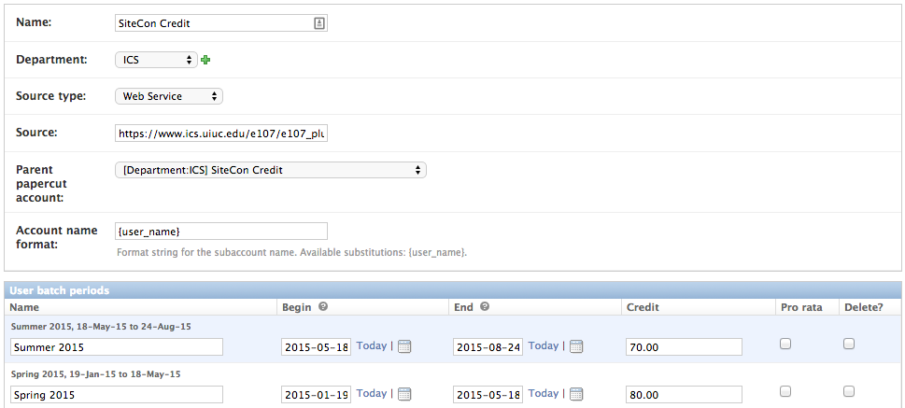
CITES PaperCut Application
User Batches: Department Credits

Slide 28
CITES PaperCut Application
Billing
Department: printer group, “Billing:ICS”, etc
NetID (affiliated) Accounts: “UOFI\UIUC Campus Accounts”
Shared Account w/PIN: CFOP + Activity Code
Multiple Personal Accounts: CFOP + Activity Code
Notes:
As a CITES service, we must export to Pinnacle for auditing purposes.
Department for billing is chosen by the printer group.
Non-NetID accounts must have their billing handled separately. Open to suggestions on how this might work in the future.
Transactions on shared accounts w/CFOP get that account; w/o CFOP they are not exported.
Multiple personal accounts also associated with a CFOP in the system.

Slide 29
Question + Answer
Stephen J. Butler, CITES-ICS
sbutler1@illinois.edu
https://github.com/sbutler/papercut

